Slide 1
Logic Apps & Azure Functions

Slide 2





Presenter
Wagner Silveira
Principal Integration Architect
@wsilveiranz

Slide 3

Agenda
Logic Apps
Azure Functions
What are Logic Apps
Concepts
Workflow Definition Language
Extensibility
Pricing
What are Azure Functions
Concepts
Languages
Triggers
Pricing
Lab Walkthrough

Slide 4
Logic Apps

Slide 5

Logic Apps
Microsoft Integration Platform as a Service (IPaaS) offering
Business Processes Orchestration in the Cloud
Azure factor (pay as you go, pay per usage, scale on demand)
Cloud and Hybrid Integration
Multiple Patterns
Manual Invocation
Event Based
Scheduled
Extensible

Slide 6
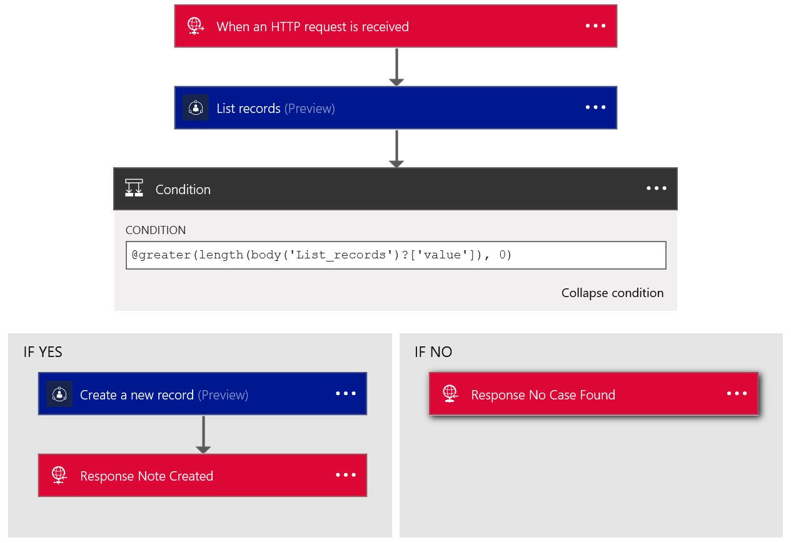
Concepts
Workflows
Triggers
Actions
Managed APIs
Flow structures

Slide 7
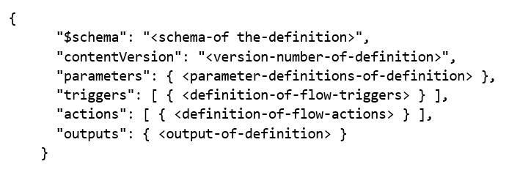
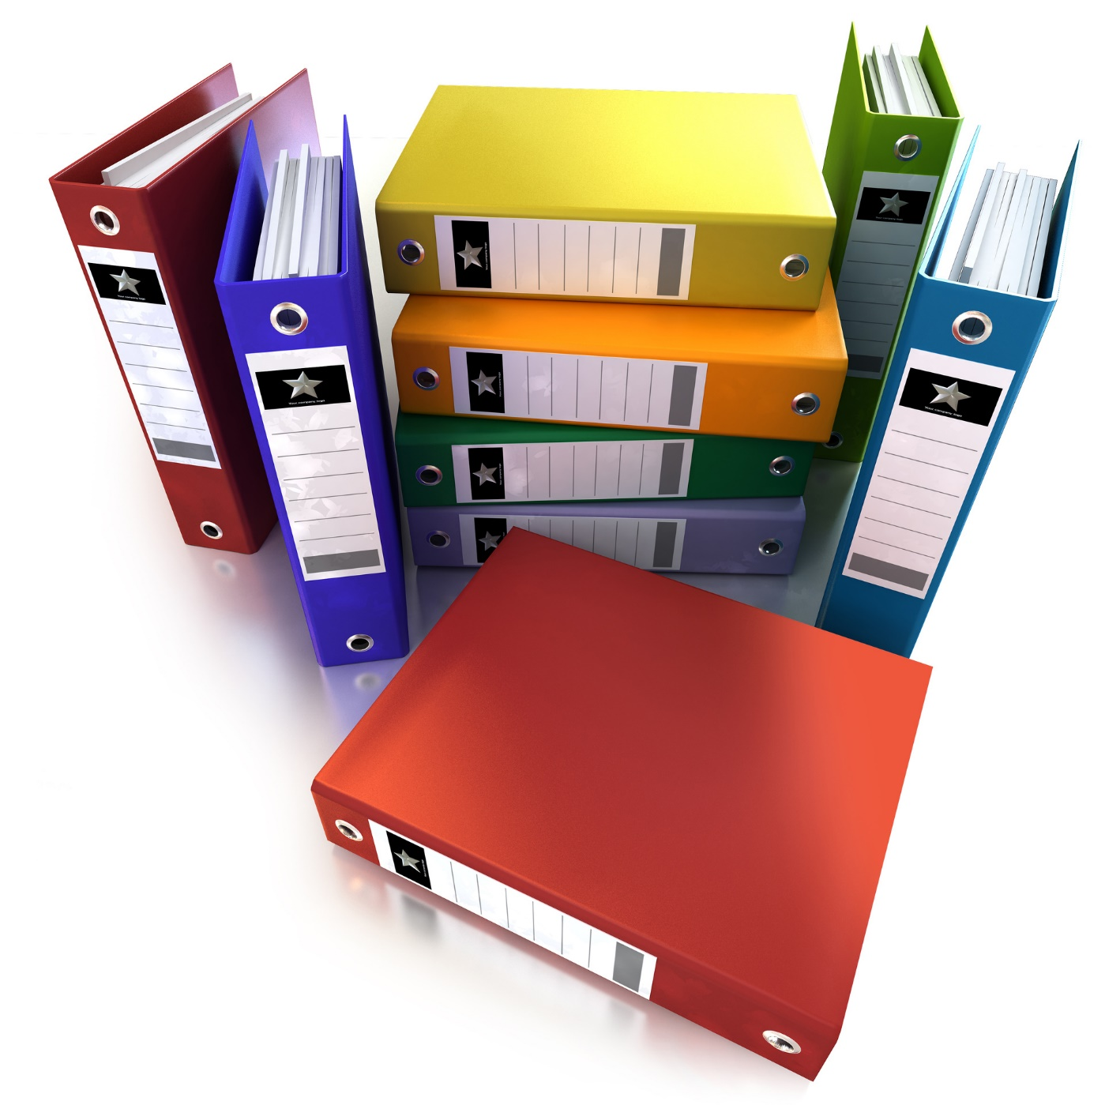
Workflow Definition Language
“Code Behind”
Basic Structure

Slide 8
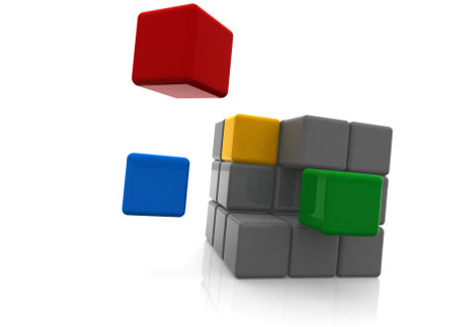
Extensibility
Consume legacy services
Web Services
External APIS
Create custom APIS
Swagger
Create micro services
Azure Functions
Expose to external systems
API Management
Store and Forward / Pub Sub
Service Bus

Slide 9
Pricing
Per Action Execution
Triggers count as execution even when not fired
Tier based price
From NZD 0.0012 to 0.000081

Slide 10


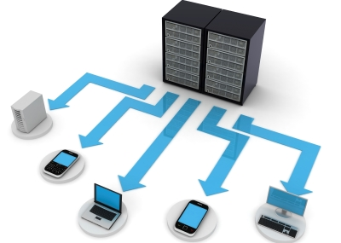
Hybrid and Enterprise Integration
Logic Apps Connection Gateway
Gateway service on-premises
Don’t require firewall changes
Selected Managed APIs
Enterprise Integration Pack
Enterprise Add On
Leverage BizTalk artefacts
XML as first class citizen
Support for Flat Files
Support for EDI (X12 and EDIFACT)

Slide 11
Azure Functions

Slide 12

What are azure functions
On Demand Computing
Code + Events
Choice of Language
Choice of Triggers
Choice of Scaling
Serverless Paradigm
1001 1001 10011001 1001 1001
1001 1001 1001
1001 1001 1001
1001 1001 1001
1001 1001 1001
1001 1001 1001
1001 1001 1001
1001 1001 1001
1001 1001 1001

Slide 13
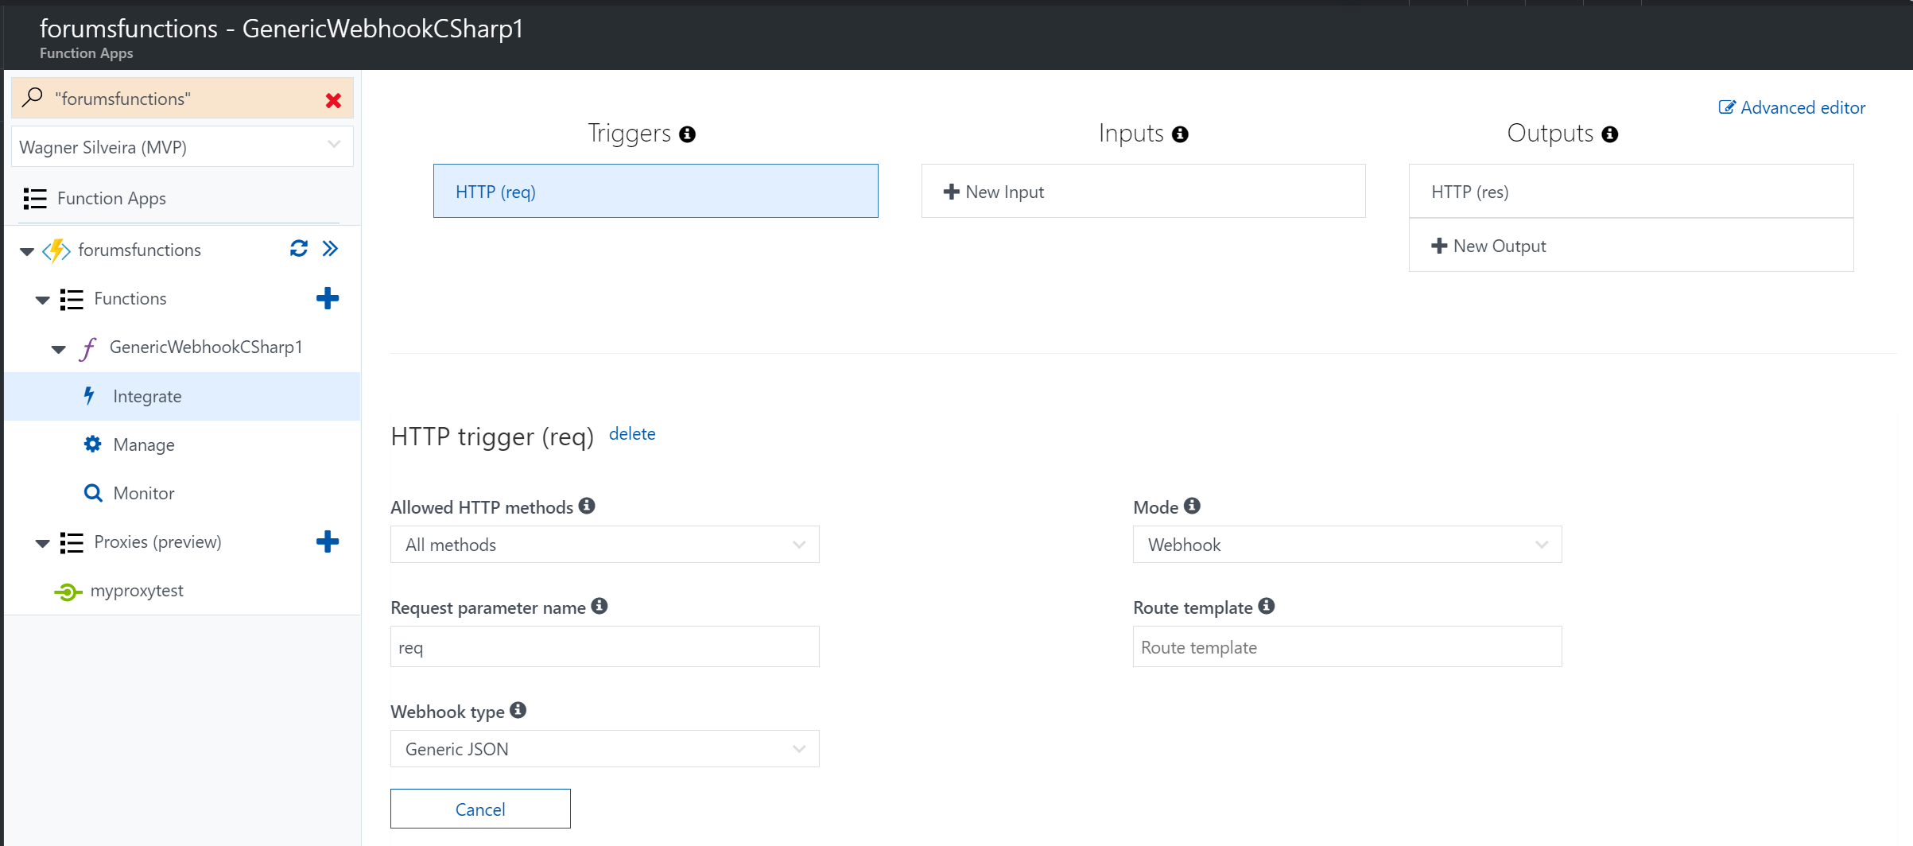
concepts
Function Apps
Functions
Triggers
Bindings
Proxies
Notes:
Need to refine this one with James – better wording / better picture?

Slide 14
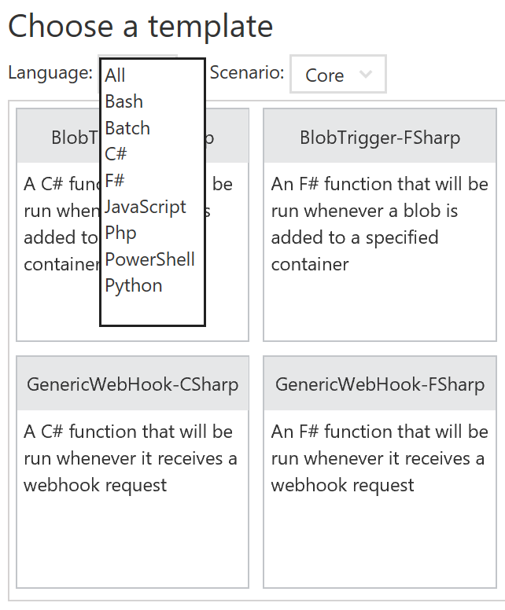
Choice of language
Programming Languages
Javascript
C#
F#
Scripting Languages
Python
PHP
Bash
Batch
PowerShell

Slide 15
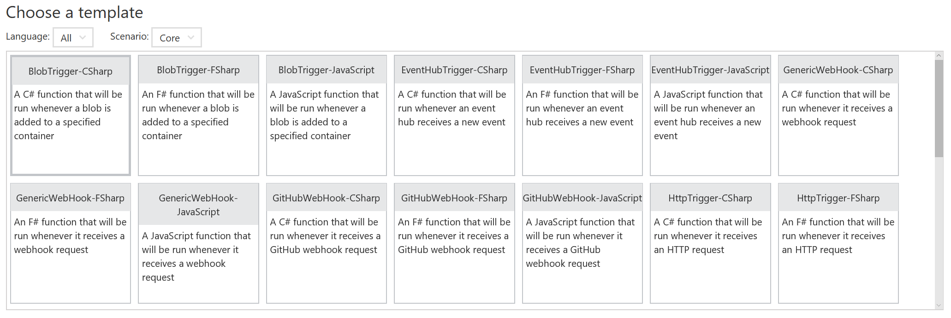
Choice of triggers

Slide 16
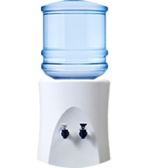
pricing
1001 1001 10011001 1001 1001 1001 100100 1001 1001 1001 1001 1 1001 1000 10101 1001 1001 1001
1001 1001 1001 100101 1001 1001
1001 1001 1001 110011 1001 1001
1001 1001 1001 010101 1001 1001
1001 1001 1001 1001 1 1001 1001 1001 1001 1001 1001 1001 1001 1001 1001 1001 1001 1001 1001 1001 1001 1001 1001 1001 1001 1001 1001 1001 1001 1001 1001 1001 1001 1001 1001 1001 1001 1001 1001 1001 1001 1001 1001 1001 1001 1001 1001 1001 1001 1001 1001 1001 1001 1001 1001
App Services x Consumption Plan
How Consumption Works
Resource Consumption
Execution time
Free allowance
Scaling Consideration
X
1001 1001 10011001 1001 1001
1001 1001 1001
1001 1001 1001
1001 1001 1001
1001 1001 1001 1001 1001 1001 1001 1001

Slide 17
Labs walkthrough

Slide 18
Overview
Notes:
Create Storage Account
Create Storage Blob Container
Create Storage Table
Provision the Function App
Build a custom function
Provision a Logic App
Build Logic App Definition
Test the Solution
Note: it may take a few minutes to provision each component on Azure.

Slide 19

Hands On time

Slide 20
Reference material
Logic Apps official page
https://azure.microsoft.com/en-us/services/logic-apps/
Introduction to Logic Apps
https://www.theta.co.nz/news-blogs/tech-blog/introduction-to-logic-apps
Logic Apps on Microsoft Docs
https://docs.microsoft.com/en-nz/azure/logic-apps/
Functions official page
https://azure.microsoft.com/en-us/services/functions/
Azure - Serverless Architecture with Azure Functions
https://msdn.microsoft.com/en-us/magazine/mt793269.aspx
In depth architectural overview – Serverless Architectures
https://martinfowler.com/articles/serverless.html

